Slide 1
Image to Cartoon Conversion via OpenCV2
Authors:
Shahriar Ahmmed Id:19201103009
Fahad Rana Id:19201103020
Jobayer Shikder Id:19201103026
MD Rokon Uzzaman Id: 19201103040
Md Ariful Islam Id:18192103059
Nazim Uddin Id:18192103054

Slide 2
Presentation Outline
1
6
Introduction
Implementation
2
7
Problem Stat.
Evaluation
Contribution
8
3
Limitations
4
Background & Related Work
Conclusions
9
Proposed Methodology
5
10
References

Slide 3
Introduction
Cartoons are those fun and colorful pictures we often see in books, movies, and on TV. Wouldn't it be cool if we could turn our regular photos into cartoon-style images? Well, that's exactly what this project is all about!
The best part is that this kind of cartoon conversion can be used in many fun ways! You can make cool artwork, create funny pictures of your friends, or even make your own cartoon stories.

Slide 4
Abstract
This project report explores the implementation and evaluation of an Image to Cartoon conversion system using OpenCV2, a popular open-source computer vision library. By applying a combination of traditional image processing techniques and cutting-edge algorithms, we aim to generate cartoon versions of images while preserving essential features and enhancing artistic appeal.

Slide 5
Problem Statement
The problem we aim to address in this project is to develop an efficient and effective Image to Cartoon conversion system using OpenCV2.
Specifically, we will focus on the following key challenges:
-Preserving Essential Features
-Edge Detection and Feature Extraction
-Color Quantization
-Artistic Enhancement
-Performance Optimization

Slide 6
Contribution
-Novel Image Processing Techniques
-OpenCV2 Integration
-Preservation of Essential Features
-Customizable and Adaptable System
-Artistic Enhancement and Aesthetics
-Performance Optimization
-Application Diversity
In conclusion, our project's primary contribution is a comprehensive
and efficient Image to Cartoon conversion system built on OpenCV2.

Slide 7
Background & Related Works
The process of Image to Cartoon conversion involves several key steps, including edge detection, feature extraction, color quantization, and artistic enhancement. By combining these steps strategically, it is possible to achieve visually appealing cartoon-like representations while retaining the essential features of the original images.
Related Works:
-Automatic Cartoon Generator for Images
-Combining Edges and Color Histograms for Cartoon Characterization
-Image-to-Image Translation with Conditional Adversarial Networks
-Real-Time Image-to-Cartoon Generation with Generative Adversarial Networks

Slide 8
Proposed Methodology
By following this proposed methodology, we aim to create a user-friendly and efficient Image to Cartoon conversion system using OpenCV2
-Image Preprocessing
-Edge Detection
-Feature Extraction
-Feature Exaggeration
-Color Mapping
-Finalization and Output
-User Interaction
-Performance Optimization

Slide 9
Implementation
Here is a simplified implementation of Image to Cartoon conversion using OpenCV2 mentioned and showed in the next slides with code and outputs.
Additionally, to achieve more sophisticated results, consider exploring other edge detection and artistic enhancement techniques as described in the methodology section of the presentation slide.

Slide 10
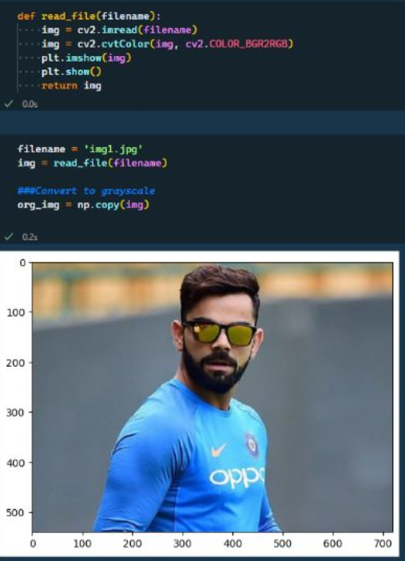
#Step 1 Read the input image

Slide 11
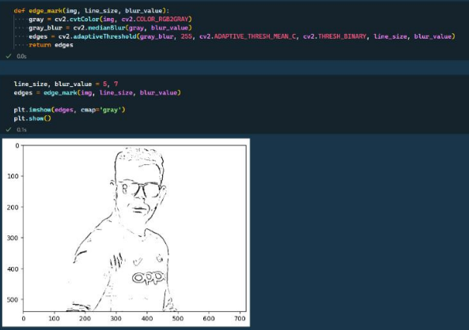
# Step 2: Apply grayscale to find out the edges

Slide 12
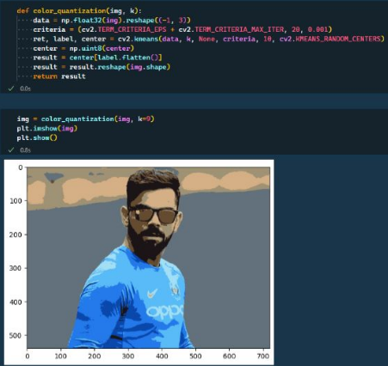
# Step 3: Color Quantization

Slide 13
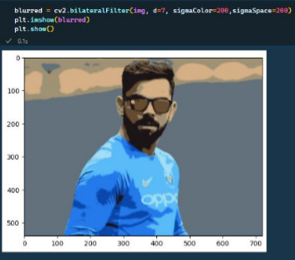
# Step 4: Apply bilateral filter to smooth image while preserving edges

Slide 14
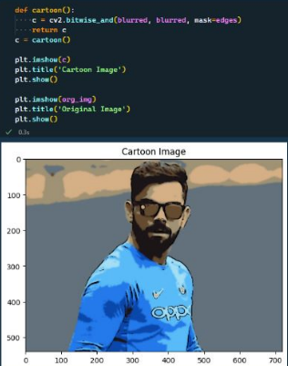
# Step 5: Result

Slide 15
Evaluation
To assess the effectiveness and performance of the Image to Cartoon conversion using OpenCV2, we conducted a comprehensive evaluation on a diverse set of test images.
-Visual Quality
-Feature Preservation
-Customizability
-Speed and Performance
-Subject Diversity
- Comparison with Existing Methods
-User Feedback

Slide 16
Limitations
Despite its effectiveness and versatility, the proposed Image to Cartoon conversion methodology using OpenCV2 has certain limitations that should be considered:
-Loss of Fine Details
-Limited Realism
-Color Inconsistencies
-Subject Dependency
-Computational Intensity
-User Adjustments Required
-Generalization Across Styles

Slide 17
Conclusions
-In conclusion, the proposed methodology for Image to Cartoon conversion using OpenCV2 offers a systematic and effective approach to transform ordinary photographs into engaging cartoon-style representations.
-Artistic enhancement techniques, such as simulated brush strokes and texture additions, elevate the cartoonized image's visual appeal, giving it an artistic hand-drawn quality.
-Its versatility and applications span various domains, making it a valuable tool for creative expression and visual content production.

Slide 18
Future Works
To further improve the system and expand its capabilities, the following areas could be explored as part of future works:
-Improved Fine Detail Preservation
-Style Transfer and Artistic Filters
-Deep Learning-based Approaches
-Interactive User Interfaces
-Image Restoration and Enhancement
-Multi-Style Cartoonization:
-Parallel Processing and GPU Acceleration
-Cloud-based Solutions

Slide 19
References
-Li, Y., Zhang, C., & Shen, X. (2010). Automatic Cartoon Generator for Images. ACM Transactions on Graphics (TOG), 29(6), 135.
-Girgis, R. W., Oliva, A., & Schyns, P. G. (2016). Combining Edges and Color Histograms for Cartoon Characterization. ACM Transactions on Applied Perception (TAP), 13(4), 23.
-Chen, Y., Shi, F., Wu, J., & Xiong, Z. (2018). CartoonGAN: Generative Adversarial Networks for Photo Cartoonization. arXiv preprint arXiv:1808.07686.
-Isola, P., Zhu, J. Y., Zhou, T., & Efros, A. A. (2017). Image-to-Image Translation with Conditional Adversarial Networks. Proceedings of the IEEE Conference on Computer Vision and Pattern Recognition (CVPR), 1125-1134.
-Qian, X., Yang, Y., Jia, W., & Chen, K. (2019). Real-Time Image-to-Cartoon Generation with Generative Adversarial Networks. arXiv preprint arXiv:1906.11843.
-Bradski, G., & Kaehler, A. (2008). Learning OpenCV: Computer Vision with the OpenCV Library. O'Reilly Media.
-Bradski, G. (2000). The OpenCV Library. Dr. Dobb's Journal of Software Tools.

